Slide 1
BIA FINAL Presentation–Group4

Slide 2
Data Trends Social Media Platforms

Slide 3
Compare Facebook, Instagram, Twitter(X) based on the above parameters :
REVENUE
POPULARITY
STOCK MARKETS
ENGAGEMENT RATE
FOLLOWERS
USER RESPONSES %

Slide 4
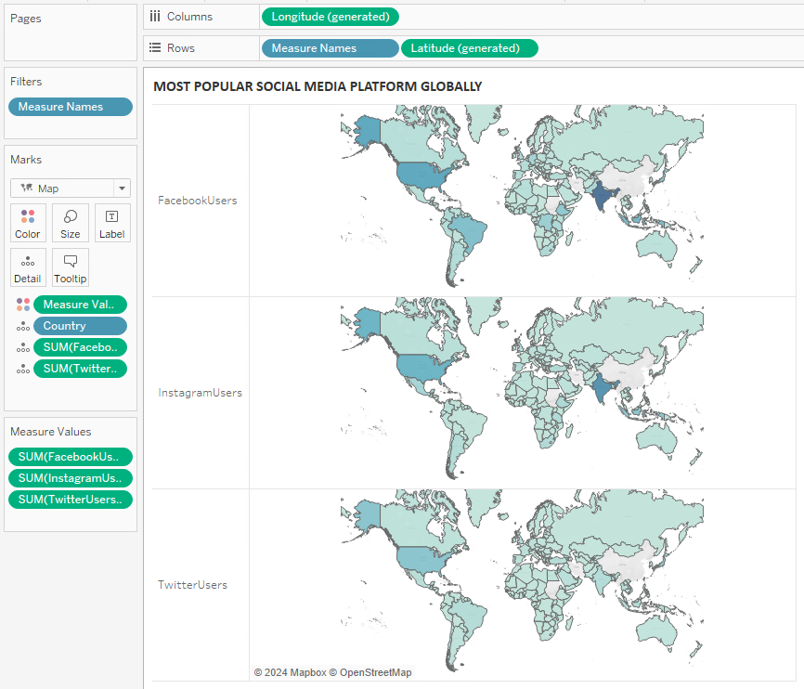
POPULARITY
Most Popular Social Media Platforms Globally 2023-2024
FACEBOOK:
Most Popular: India
Least Popular: Mongolia
INSTAGRAM:
Most Popular: India
Least Popular: Mongolia
TWITTER:
Most Popular: USA
Least Popular: Western Sahara

Slide 5
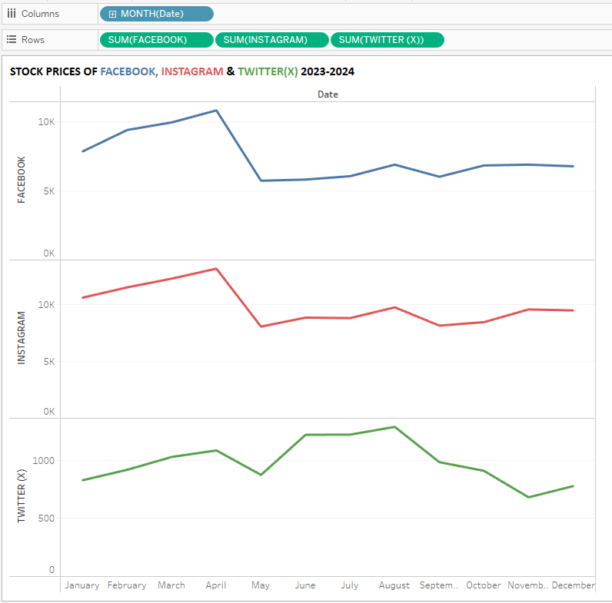
STOCK MARKET
Stock Market Trends For Social Media Platforms 2023-2024
All three social media platforms saw a rise in stock prices in April 2023.
May 2023 saw a drastic fall of the stock prices across all three platforms.
Instagram and Facebook kept a steady rate for the rest of the year.
Twitter(X) saw a decline after August and remained so for the rest of the year.

Slide 6
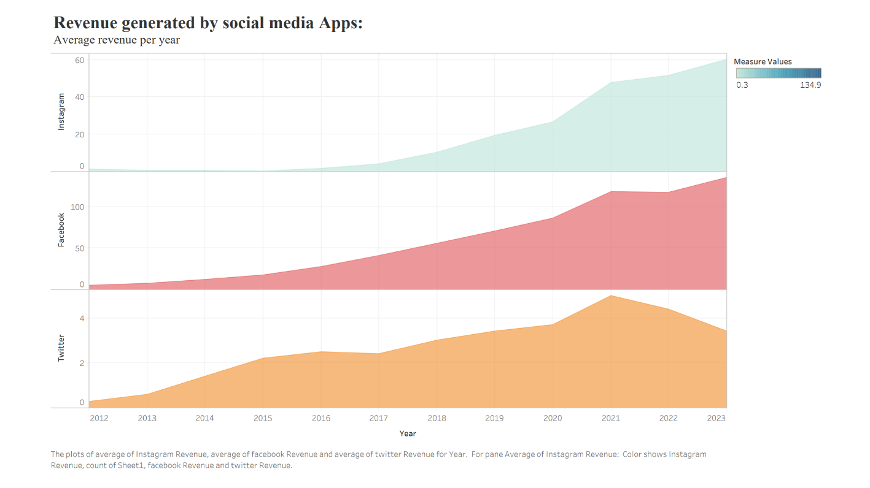
REVENUE
Revenue Generated by Social Media Accounts in 2024?
Instagram:
Revenue started at $1.4 billion in 2012 and fluctuated over the years, reaching $60.3 billion in 2023.
Facebook:
Revenue started at $5.08 billion in 2012 and increased steadily, reaching $134.9 billion in 2023.
Twitter:
Revenue started at $0.3 billion in 2012 and reached $4.4 billion in 2022. In 2023, it dropped to $3.4 billion.

Slide 7
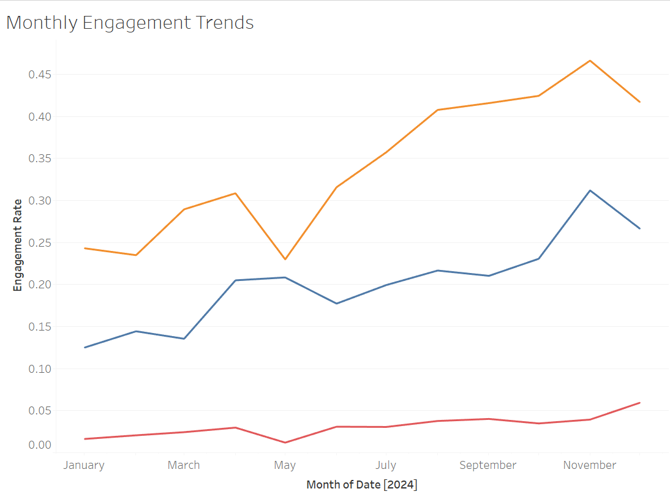
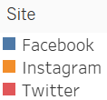
ENGAGEMENT RATE
Monthly Engagement Rate Changes Across Multiple Platforms?
Engagement is on the rise since January 2024, with September boasting the highest number.
Seasonal fluctuations exist as engagement dips occurred in February and August
Facebook leads in followers and holds the top spot with over 310,000 followers in December 2023.
Instagram shows steady growth as it gains at least 1,000 new followers monthly.

Slide 8
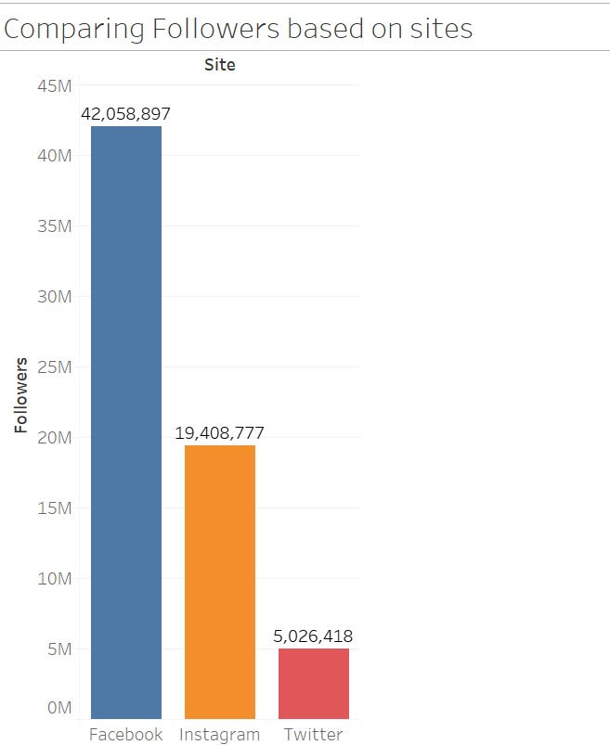
FOLLOWERS
Compare the number of social media followers across platforms?
Twitter has reached over 5 million followers, primarily focusing on real-time updates and brief interactions.
Instagram boasts over 19 million followers, content appealing particularly to younger demographics.
Facebook leads with over 42 million followers, catering to a diverse range of audience.
This data indicates significant engagement and outreach across these three major social media platforms.

Slide 9
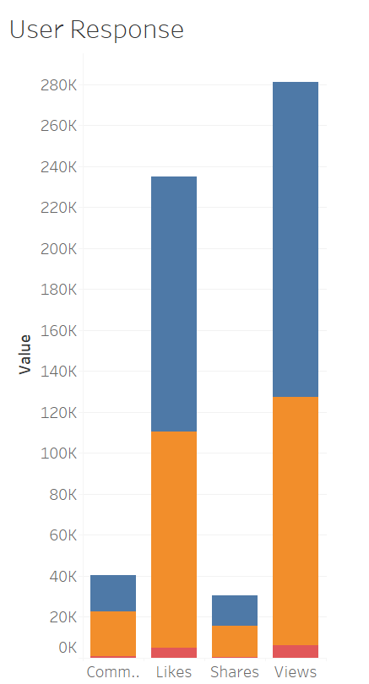
USER RESPONSES
Compare the User Responses across the social media platforms
Few customers have commented and shared but most of the customer did like and viewed.
Among three social platform twitter has got least response.
Facebook and Instagram have almost same response.

Slide 10
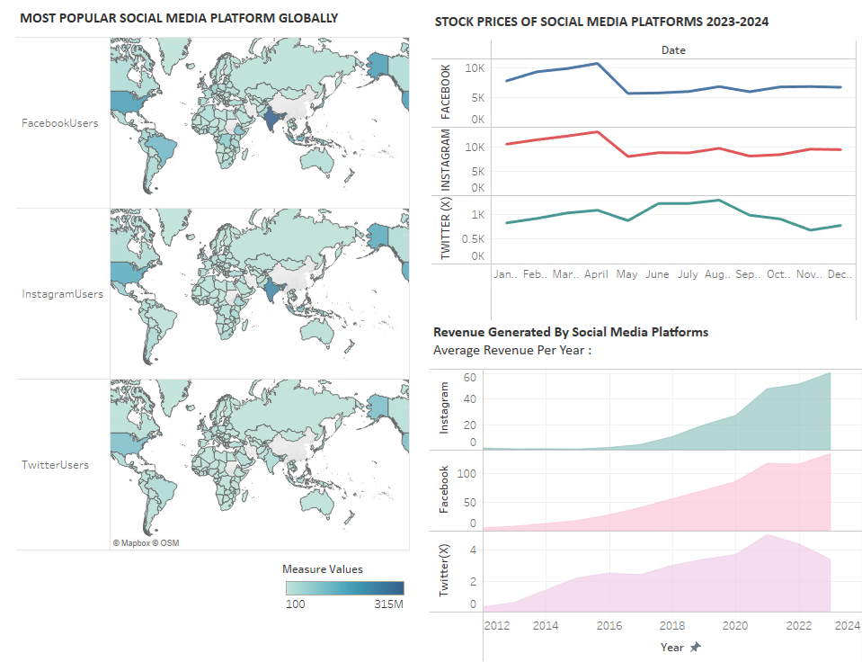
Comparing All Data-Trends together

Slide 11
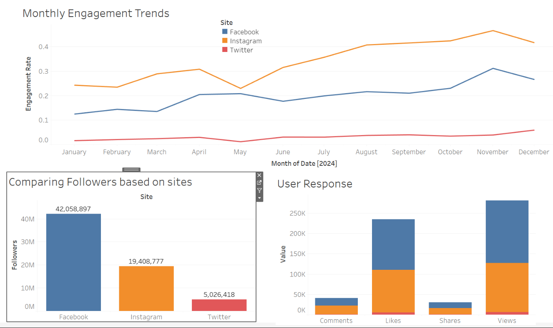
Comparing All Data-Trends together

Slide 12
Lessons Learnt during the Project :
When working with Tableau visualizations, it's crucial to:
Keep it simple to convey your message clearly.
Choose the right chart types for your data.
Use color strategically without overwhelming the viewer.
Optimize for performance, especially with large datasets.
Construct a narrative to guide viewers through the data.
Iterate and refine your visualization design based on feedback.

